Slide 1
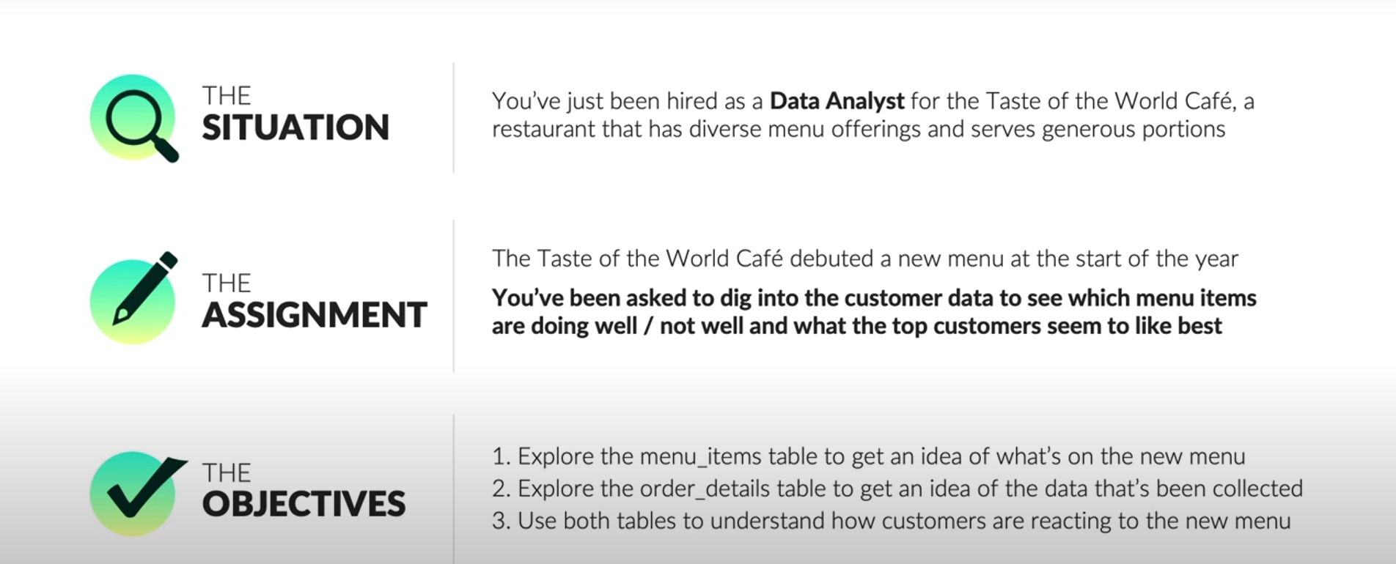
Restaurant Operations Analysis

Slide 2
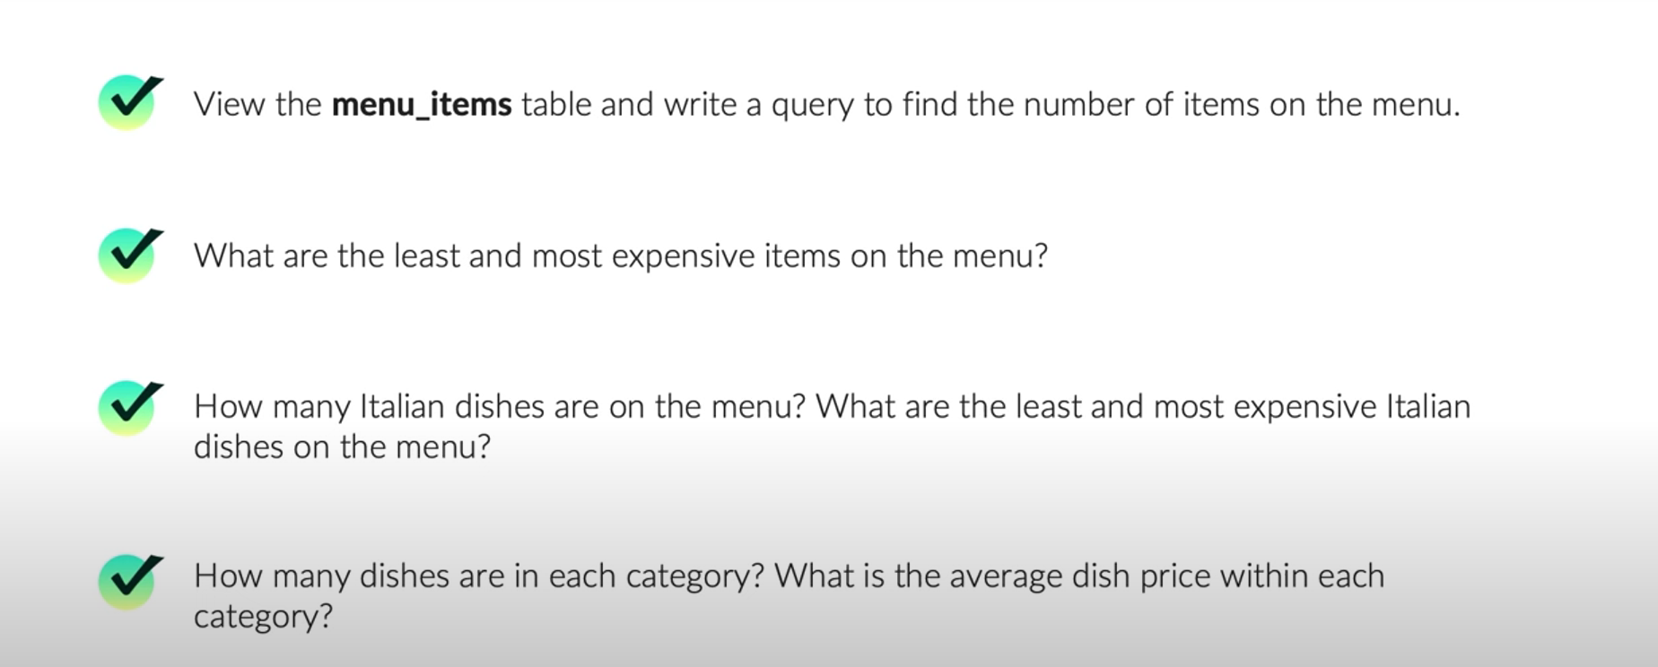
Objective 1: Explore the Items Table

Slide 3
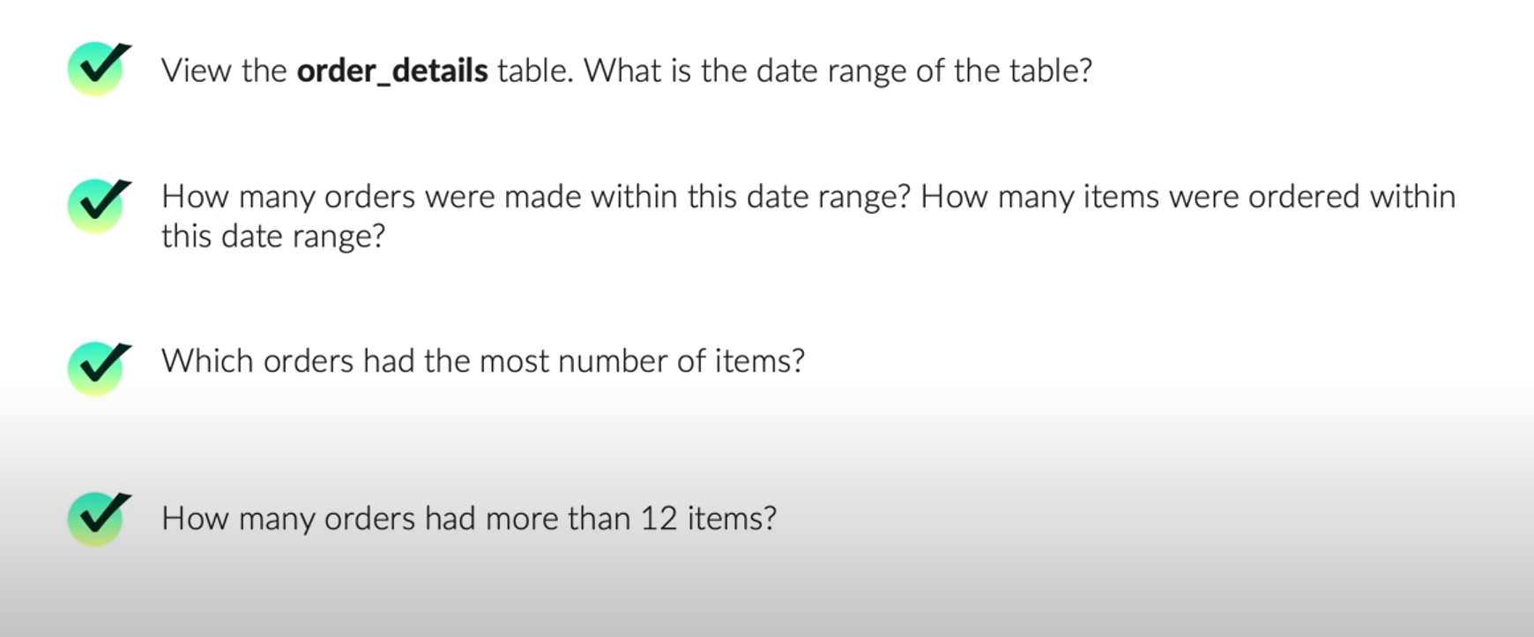
Objective 2: Explore the Orders Table

Slide 4
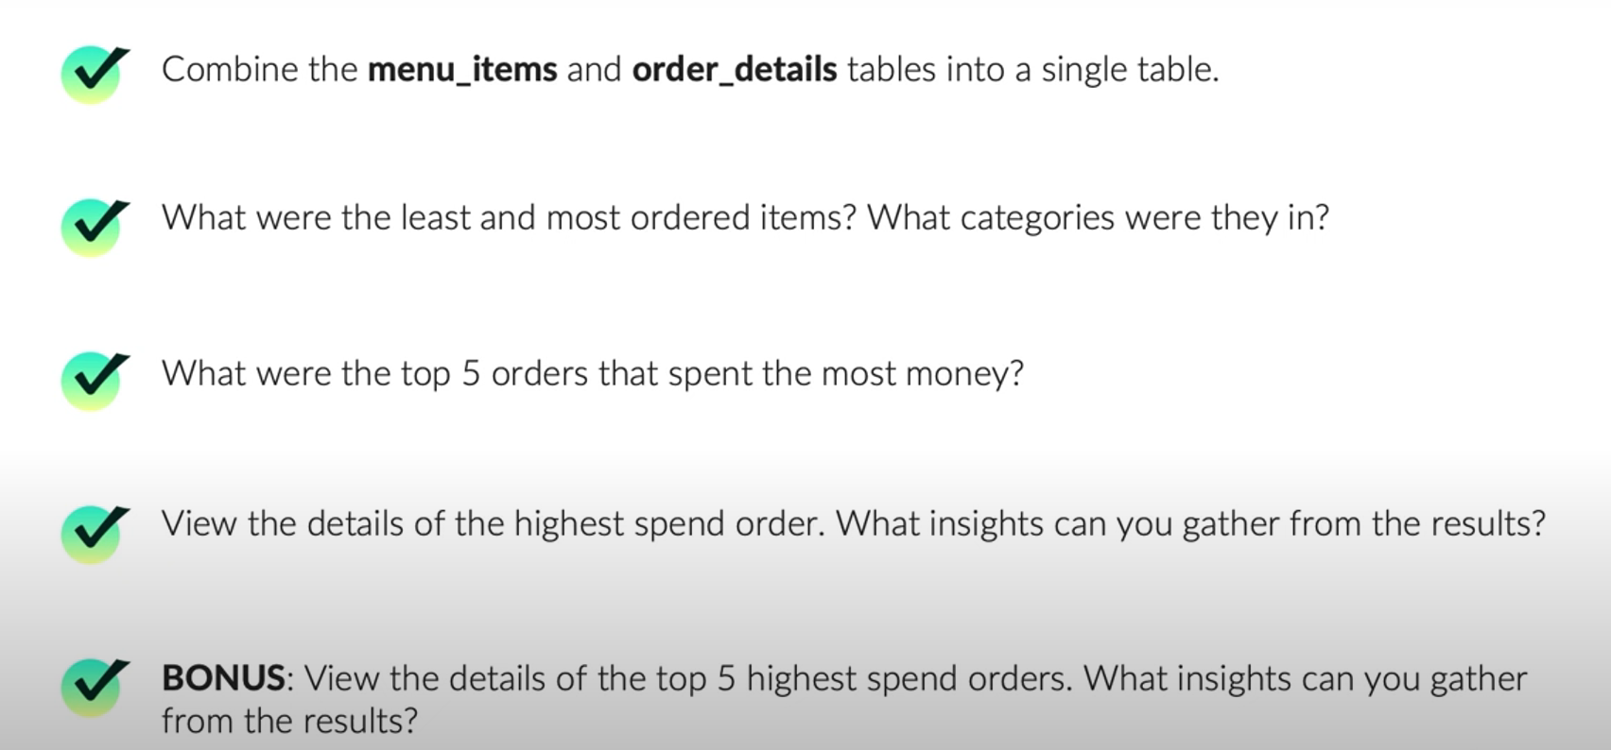
Objective 3: Analyse the Customer Behaviour

Slide 5
References
Maven Analytics Datasets and Project Briefs.

